Slide 1
Lesson 7: What is the internet?
Mack 2023
Notes:
Last updated 30-06-2021
Resources are updated regularly — the latest version is available at: ncce.io/tcc.
This resource is licensed under the Open Government Licence, version 3. For more information on this licence, see ncce.io/ogl.

Slide 2
Draw the following network topologies:
Starter activity
A
B
C
D
Star
Bus
Ring
Mesh

Slide 3
Draw the following network topologies:
Starter activity
A
B
C
D
Star
Bus
Ring
Mesh

Slide 4

Lesson 7: What is the internet?
Objectives
In this lesson, you will:
Describe the internet as a network of computer networks
Describe the function of an IP address
Describe a DNS and its role in the conversion of a URL to an IP address
Describe the role and function of a web browser

Slide 5

What is the internet?
Activity 1
The internet is a global network of networks.
It is an infrastructure that is used to share data and resources on a global scale.
Notes:
Image source: https://pixabay.com/illustrations/background-data-network-web-3228704/

Slide 6

How did it start?
Activity 1
The first workable prototype of the internet occurred in the 1960s as part of an American defense department called ARPA (Advanced Research Projects Agency).
They wanted to create a network that could survive a nuclear attack.
Notes:
Image source: https://pixabay.com/photos/atomic-bomb-mushroom-cloud-explosion-1011738/

Slide 7
Centralised networks
Activity 1
Before this prototype, networks were centralised.
This meant that all of the data was transmitted from a central location.

Slide 8

Centralised networks
Activity 1
If a nuclear attack occured at the central location then the network would become unusable.

Slide 9
Centralised networks
Activity 1
Also, all of the data was transmitted in a single transmission. This meant that if a link was broken then the whole transmission would be lost.
Centralised networks were also very slow and used up a lot of bandwidth.
01100110101010110

Slide 10
Distributed network
Activity 1
The team at ARPA decided it would be better to avoid having a single, central location for data.
They developed the concept of a distributed network.

Slide 11
Distributed network
Activity 1
✉
This meant that data could be transmitted through multiple routes across the network.
It also meant that there was no longer a single, central location for important data.
✉

Slide 12
Distributed network
Activity 1
✉
If a nuclear attack occured in one area then a new route could be calculated.
✉

Slide 13
Packet switching
Activity 1
This was further enhanced by the concept of packet switching.
Data files could be broken down into smaller packets.
✉

Slide 14
Packet switching
Activity 1
This was further enhanced by the concept of packet switching.
Data files could be broken down into smaller packets.
✉
✉
✉
✉

Slide 15
Packet switching
Activity 1
These could then be sent separately along the most efficient route.
✉
✉
✉
✉

Slide 16
Packet switching
Activity 1
These could then be sent separately along the most efficient route.
✉
✉
✉
✉

Slide 17
Packet switching
Activity 1
✉
These could then be sent separately along the most efficient route.
✉
✉
✉

Slide 18
Packet switching
Activity 1
✉
✉
✉
These could then be sent separately along the most efficient route.
✉

Slide 19
Packet switching
Activity 1
✉
✉
✉
✉
And re-ordered at the destination.

Slide 20
Scaling up the internet
Activity 1
In order for the internet to be scaled up for wider use, many protocols needed to be agreed.
These are sets of rules used for communication.

Slide 21
TCP/IP protocol suite
Activity 1
TCP/IP is one of the suites of protocols that is used to transmit data over the internet.
You will learn more about TCP/IP in a future lesson.

Slide 22
TCP/IP protocol suite
Activity 1
TCP deals with breaking data into packets, distributing them, and re-ordering them at the destination.
IP is responsible for making sure that the data arrives at the correct destination.

Slide 23
What networking system is the internet based on?
Activity 1
Distributed
Centralised

Slide 24
What networking system is the internet based on?
Activity 1
Distributed

Slide 25

The IP address
Activity 1
Every single device that connects to the internet needs a unique address called an IP address.
An IP address is a series of numbers like the one seen here.
The IP suite of protocols determines the rules for how an IP address is created and used.
192.168.1.1
IP Address

Slide 26
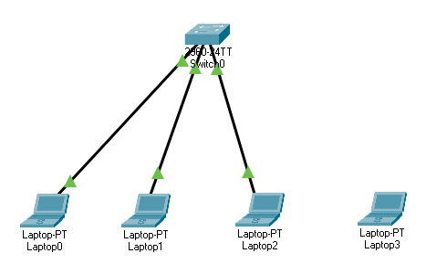
The IP address
Activity 1
In Lesson 5 you used Packet Tracer to add a laptop to a wired network.
When you added the laptop, you had to give it an IP address.
This was so it could be located on the network.

Slide 27

The IP address
Activity 1
An IP address works in a similar way to the address for houses and buildings.
Each building has its own, unique address that the postal service and delivery companies use to deliver mail to the correct recipient.
Notes:
Image source: https://pixabay.com/photos/number-digit-house-number-nineteen-192346/

Slide 28

The IP address
Activity 1
Every device on the internet has its own, unique IP address.
192.168.1.1
Notes:
Image source: https://pixabay.com/vectors/laptop-pc-computer-technology-2243898/

Slide 29
The IP address
Activity 1
When you request data through the internet, the request is made through your chosen internet service provider (ISP).
ISP
192.168.1.1
Notes:
Image source: https://pixabay.com/vectors/laptop-pc-computer-technology-2243898/

Slide 30
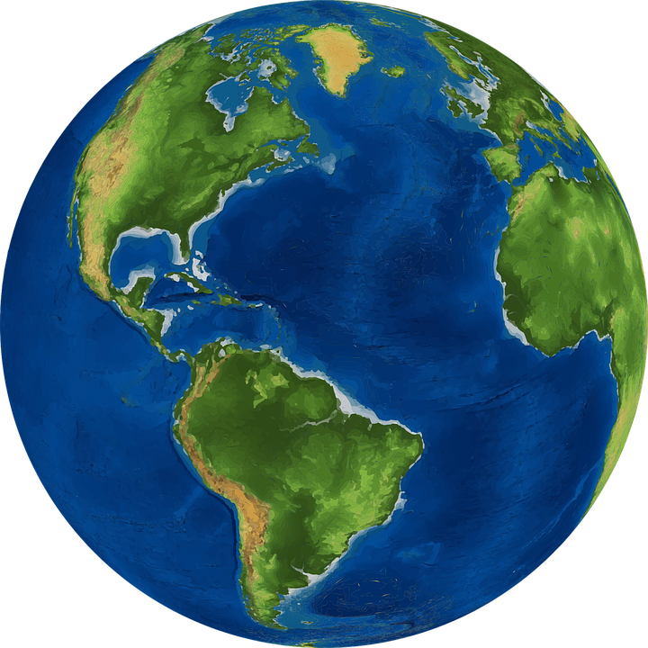
The IP address
Activity 1
Your ISP connects you to the billions of devices that are connected to the internet.
ISP
192.168.1.1
Notes:
Image source: https://pixabay.com/vectors/laptop-pc-computer-technology-2243898/
Image source: https://pixabay.com/vectors/world-earth-planet-globe-map-1301744/

Slide 31
The IP address
Activity 1
Each, with their own unique IP address.
283.132.9.1
198.132.9.1
192.132.9.1
187.132.8.1
ISP
199.182.9.1
296.132.9.1
192.168.1.1
196.171.4.1
322.132.2.1
Notes:
Image source: https://pixabay.com/vectors/laptop-pc-computer-technology-2243898/
Image source: https://pixabay.com/vectors/world-earth-planet-globe-map-1301744/

Slide 32
The IP address
Activity 1
Each, with their own unique IP address.
You will learn more about this in activity 2.
283.132.9.1
198.132.9.1
192.132.9.1
187.132.8.1
ISP
199.182.9.1
296.132.9.1
192.168.1.1
196.171.4.1
322.132.2.1
Notes:
Image source: https://pixabay.com/vectors/laptop-pc-computer-technology-2243898/
Image source: https://pixabay.com/vectors/world-earth-planet-globe-map-1301744/

Slide 33
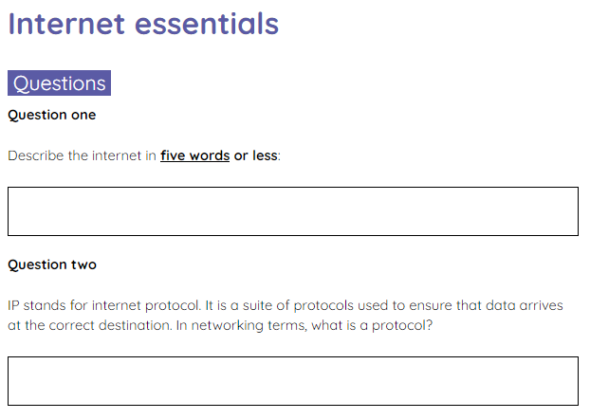
Internet essentials
Activity 1
Complete the activity 1 sheet to check your understanding of the internet essentials that were covered in this activity.

Slide 34

What is the internet?
Activity 2
The internet is a global network of networks.
It allows data to be transferred to and from any location with an internet connection.

Slide 35
The World Wide Web (WWW)
Activity 2
The internet can be used to access the World Wide Web (WWW).
The WWW is a collection of web pages.
The internet and the WWW are two different things that are often incorrectly viewed as the same.

Slide 36
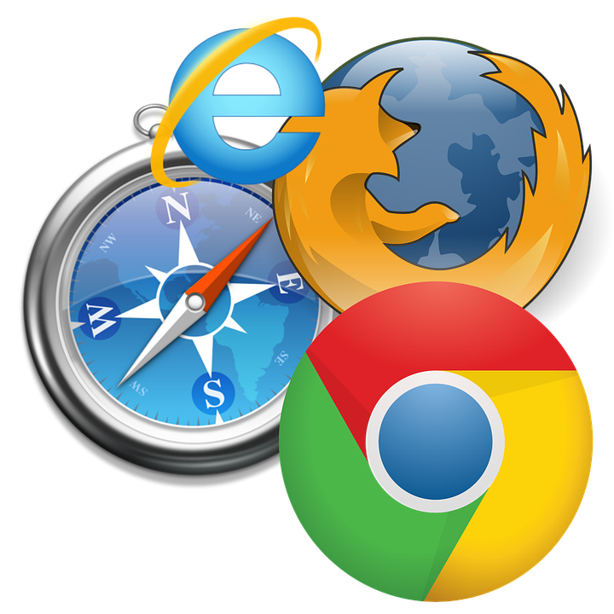
The web browser
Activity 2
In order to navigate the WWW you need a web browser.
The most widely used web browsers are:
Google Chrome
Safari
Firefox
Microsoft Edge
Notes:
Image source: https://pixabay.com/illustrations/browser-web-www-computer-773215/

Slide 37
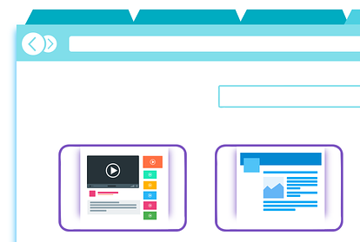
How does a web browser work?
Activity 2
To access a web page on the WWW you enter a website address into the address bar at the top of your browser.
This website address is known as a Uniform Resource Locator (URL).
raspberrypi.org

Slide 38
How does a web browser work?
Activity 2
A website address is a user friendly way of writing the IP address location of the server that stores the website.
It would be very hard to remember the IP address of every website that you wish to use, so a naming system is used instead.
raspberrypi.org

Slide 39
Domain Name System (DNS)
Activity 2
DNS is a domain name system that associates a website address with its IP address.
When you type raspberrypi.org into your browser, the browser will perform a series of checks on that address.
raspberrypi.org

Slide 40
Domain Name System (DNS)
Activity 2
First, it will check if you have visited the website before. If you have, then your computer will already know the IP address.
If unsuccessful it will use the DNS to find the IP address for the website.
There are thousands of DNS servers across the globe. You will learn more about these in activity 3.
raspberrypi.org

Slide 41
Domain Name System (DNS)
Activity 2
Once the web browser knows the IP address of the website, it can move on to the next step.
IP located...
172.67.36.98

Slide 42
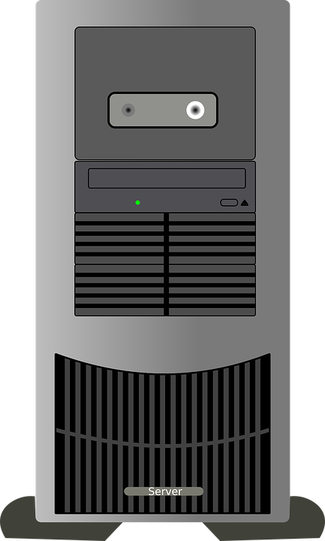
How does a web browser work?
Activity 2
The web browser establishes a connection with the web server at the IP location specified by the DNS.
raspberrypi.org
172.67.36.98

Slide 43
How does a web browser work?
Activity 2
The web browser then makes a request for the web page.
Can I have a copy of the RaspberryPi.org homepage please?
raspberrypi.org
172.67.36.98

Slide 44
How does a web browser work?
Activity 2
The server will then check what has been requested and start to build a response.
Certainly, I will just get that for you.
raspberrypi.org
172.67.36.98

Slide 45
How does a web browser work?
Activity 2
Web pages are typically built using a markup language known as HTML. The server will prepare the HTML required to build the web page in your browser.
<HTML>
</HTML>
raspberrypi.org
172.67.36.98

Slide 46
How does a web browser work?
Activity 2
It will then send that HTML page and any other files, like images to your computer.
<HTML>
</HTML>
raspberrypi.org
172.67.36.98

Slide 47
How does a web browser work?
Activity 2
The browser then takes the HTML and builds the web page within your browser.
<HTML>
</HTML>
172.67.36.98

Slide 48
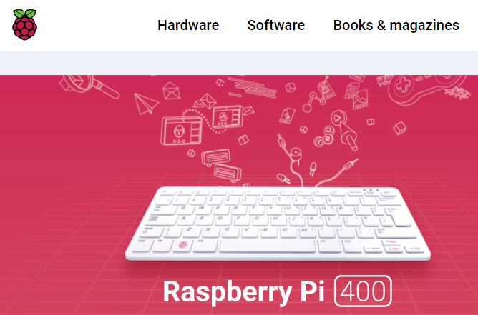
How does a web browser work?
Activity 2
This is then displayed as a fully functioning web page.
172.67.36.98

Slide 49
Website differences
Activity 2
Websites can come in many different forms. They aren’t always a single, static page.
They can also be dynamic. Dynamic pages can be made up of different elements taken from different web servers.
These elements can be based on your browsing history and tailored towards you.

Slide 50
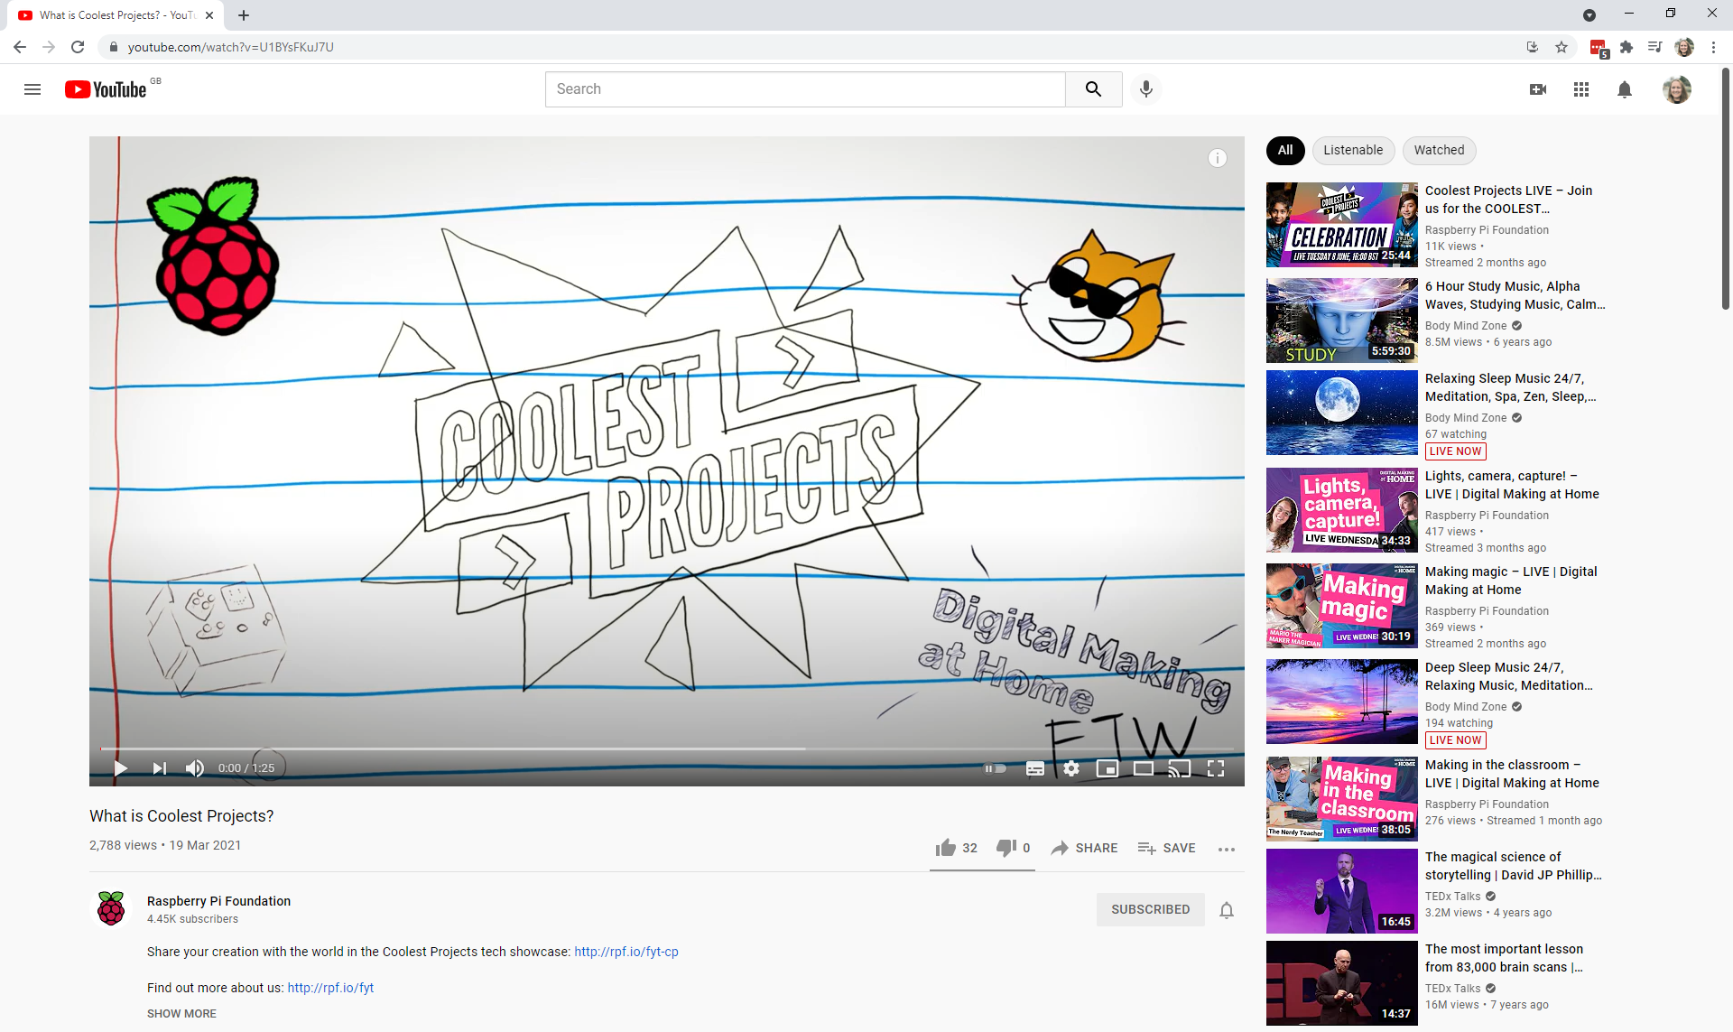
An example: YouTube
Activity 2
When you click on a video that you want to watch, the web page that appears in your browser is made up of different elements.

Slide 51
An example: YouTube
Activity 2
The top bar allows you to search for another video or access your account information.

Slide 52
An example: YouTube
Activity 2
The video element is streamed from one of thousands of servers.

Slide 53
An example: YouTube
Activity 2
The comments will be linked to the video through the help of a powerful database.

Slide 54
An example: YouTube
Activity 2
The view next thumbnails will be created using an algorithm based on your viewing habits and the habits of other viewers that have watched the same video.

Slide 55
An example: YouTube
Activity 2
All of these elements are packaged together and delivered to your computer to be built by your web browser.
And it all happens in seconds (depending on your internet connection).

Slide 56
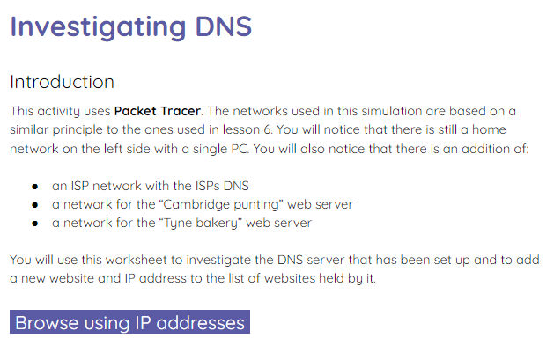
Investigating DNS
Activity 2
Use the activity 2 sheet to investigate a DNS server using a simulation in Packet Tracer.

Slide 57
Domain Name System: a further exploration
Activity 3
A DNS server isn’t just one single server. There are thousands of DNS servers all around the world.
If your computer doesn’t know the IP address for the website that you need then it will try and find that IP address in the fastest way possible.
There is a process for this.

Slide 58
Domain Name System: a further exploration
Activity 3
First it checks with your ISP’s DNS server.
For example,
Sky Broadband has two DNS servers that store the most commonly visited website IP addresses that their customers view.
Sky Primary DNS
Sky Secondary DNS
Sky broadband DNS

Slide 59
Domain Name System: a further exploration
Activity 3
No idea!
If the website’s IP address can not be found here then it checks the fastest available root DNS server.
Sky Primary DNS
Sky Secondary DNS
Root DNS
Root DNS

Slide 60
Domain Name System: a further exploration
Activity 3
The root DNS server is at the very top of the DNS server hierarchy.
It knows the location of all of the DNS servers on the top level domain (TLD).
Root DNS

Slide 61
Domain Name System: a further exploration
Activity 3
The top level domain (TLD) contains IP addresses for specific domain name extensions such as .com and .uk.
Root DNS
.com
.uk
.net
.info
Top level domain

Slide 62
Domain Name System: a further exploration
Activity 3
If the computer is trying to access the IP address for a .com URL then it will go to the .com TLD server.
Root DNS
.com
.uk
.net
.info

Slide 63
Domain Name System: a further exploration
Activity 3
The .com TLD server will then have a list of all of the authoritative name servers (ANS).
These are the web servers that use a .com extension.
For example,
www.google.com
www.youtube.com
Root DNS
.com
.uk
.net
.info
google
youtube

Slide 64
Domain Name System: a further exploration
Activity 3
The authoritative name servers (ANS) for Google will be able to tell your computer the IP address for google.com.
Root DNS
.com
.uk
.net
.info
I know it! It’s
8.8.8.8
google
youtube

Slide 65
URL structure
Activity 3
The structure of the URL is used to find the DNS server that can locate the website’s IP address.
www.google.co.uk

Slide 66
URL structure
Activity 3
First it goes to the root. Which is actually a hidden . at the end of the URL.
www.google.co.uk
The root

Slide 67
URL structure
Activity 3
Next, it checks the top level domain (TLD).
www.google.co.uk
TLD

Slide 68
URL structure
Activity 3
Then it moves down the structure to find the DNS servers for .co.
www.google.co.uk
Sometimes referred to as the 2nd level domain

Slide 69
URL structure
Activity 3
And finally it goes to the authoritative name server for the domain.
www.google.co.uk
Sometimes referred to as the 3rd level domain

Slide 70
Write a definition for each of these terms
Wrap Up
IP address
DNS
Web browser

Slide 71
Write a definition for each of these terms: solutions
Wrap Up
IP address
A term used to describe the numeric pattern assigned to each device on a network. Used to locate devices.
DNS
Stands for Domain Name System. It is a collection of servers that lists commonly used website addresses and their IP addresses. There are thousands around the world.
Web browser
A piece of software that is used to browse websites on the WWW. It accesses and downloads the website data and builds the page.

Slide 72
Next lesson
Summary
In this lesson, you…
Learnt about the internet, how it is structured, and how web browsers access content from web servers
Next lesson, you will…
Learn about web hosting services and how these work

